Slide 1
Hospital Data System
Group Presentation By
Date: 04 November 2024
Mokekoloana Modiba
Vuyelo Hlungwane
Jessica Sewape
Lesedi Motau &
Linda Skhosana

Slide 2
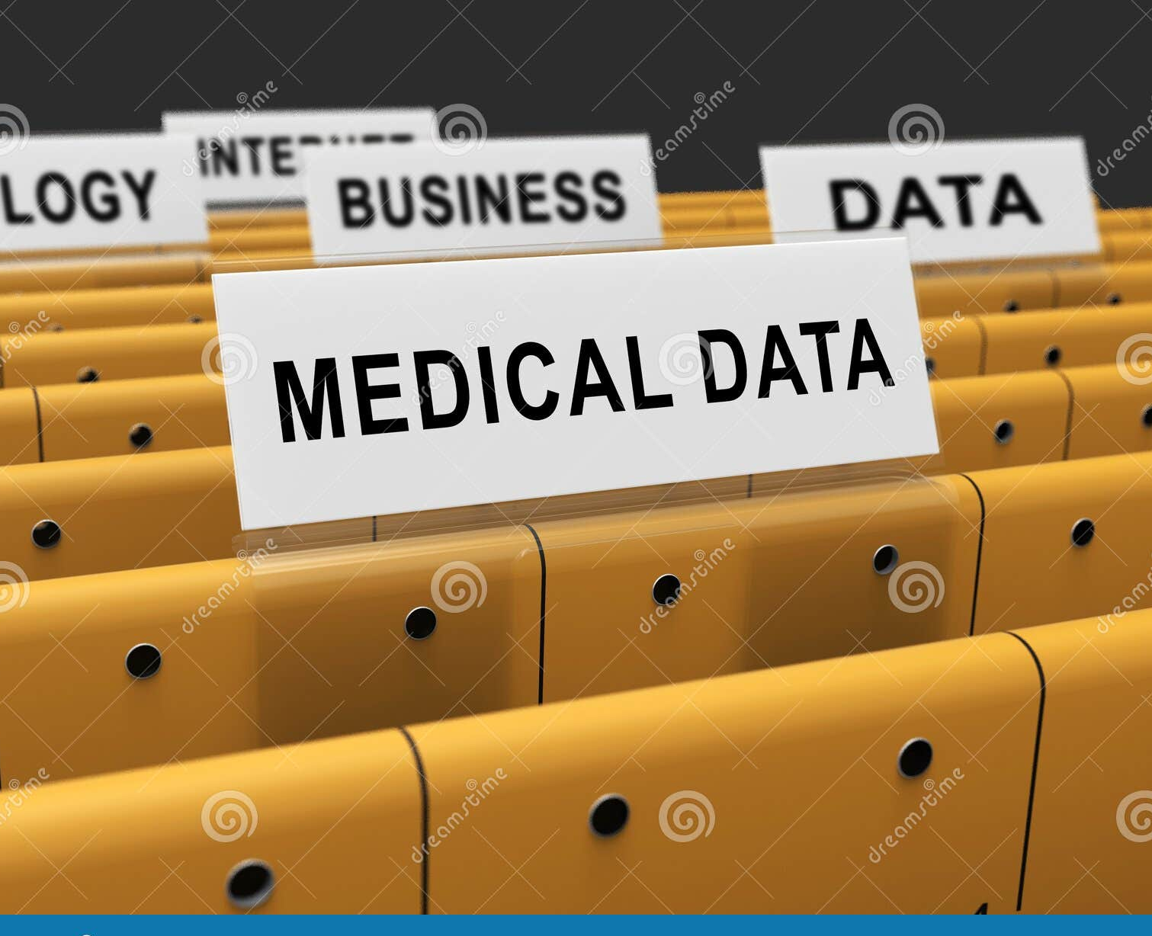
The Backbone of Healthcare: Implementing a Hospital Database System
Introduction to the Hospital Database System
Entity-Relationship Diagram (ERD)
Oracle Data Modeler Implementation
Database Schema Design
Coding with Developer
Benefits of the Database System
Future Enhancements
Conclusion

Slide 3

Introduction to the Hospital Database System
Our hospital database system is designed to streamline patient data management and improve healthcare delivery. By centralizing patient information, scheduling, and medical records, it addresses issues like inefficient data entry, slow record retrieval, and the need for enhanced data security. Our goal is to make data management more efficient, accessible, and secure for hospital staff and patients alike.

Slide 4
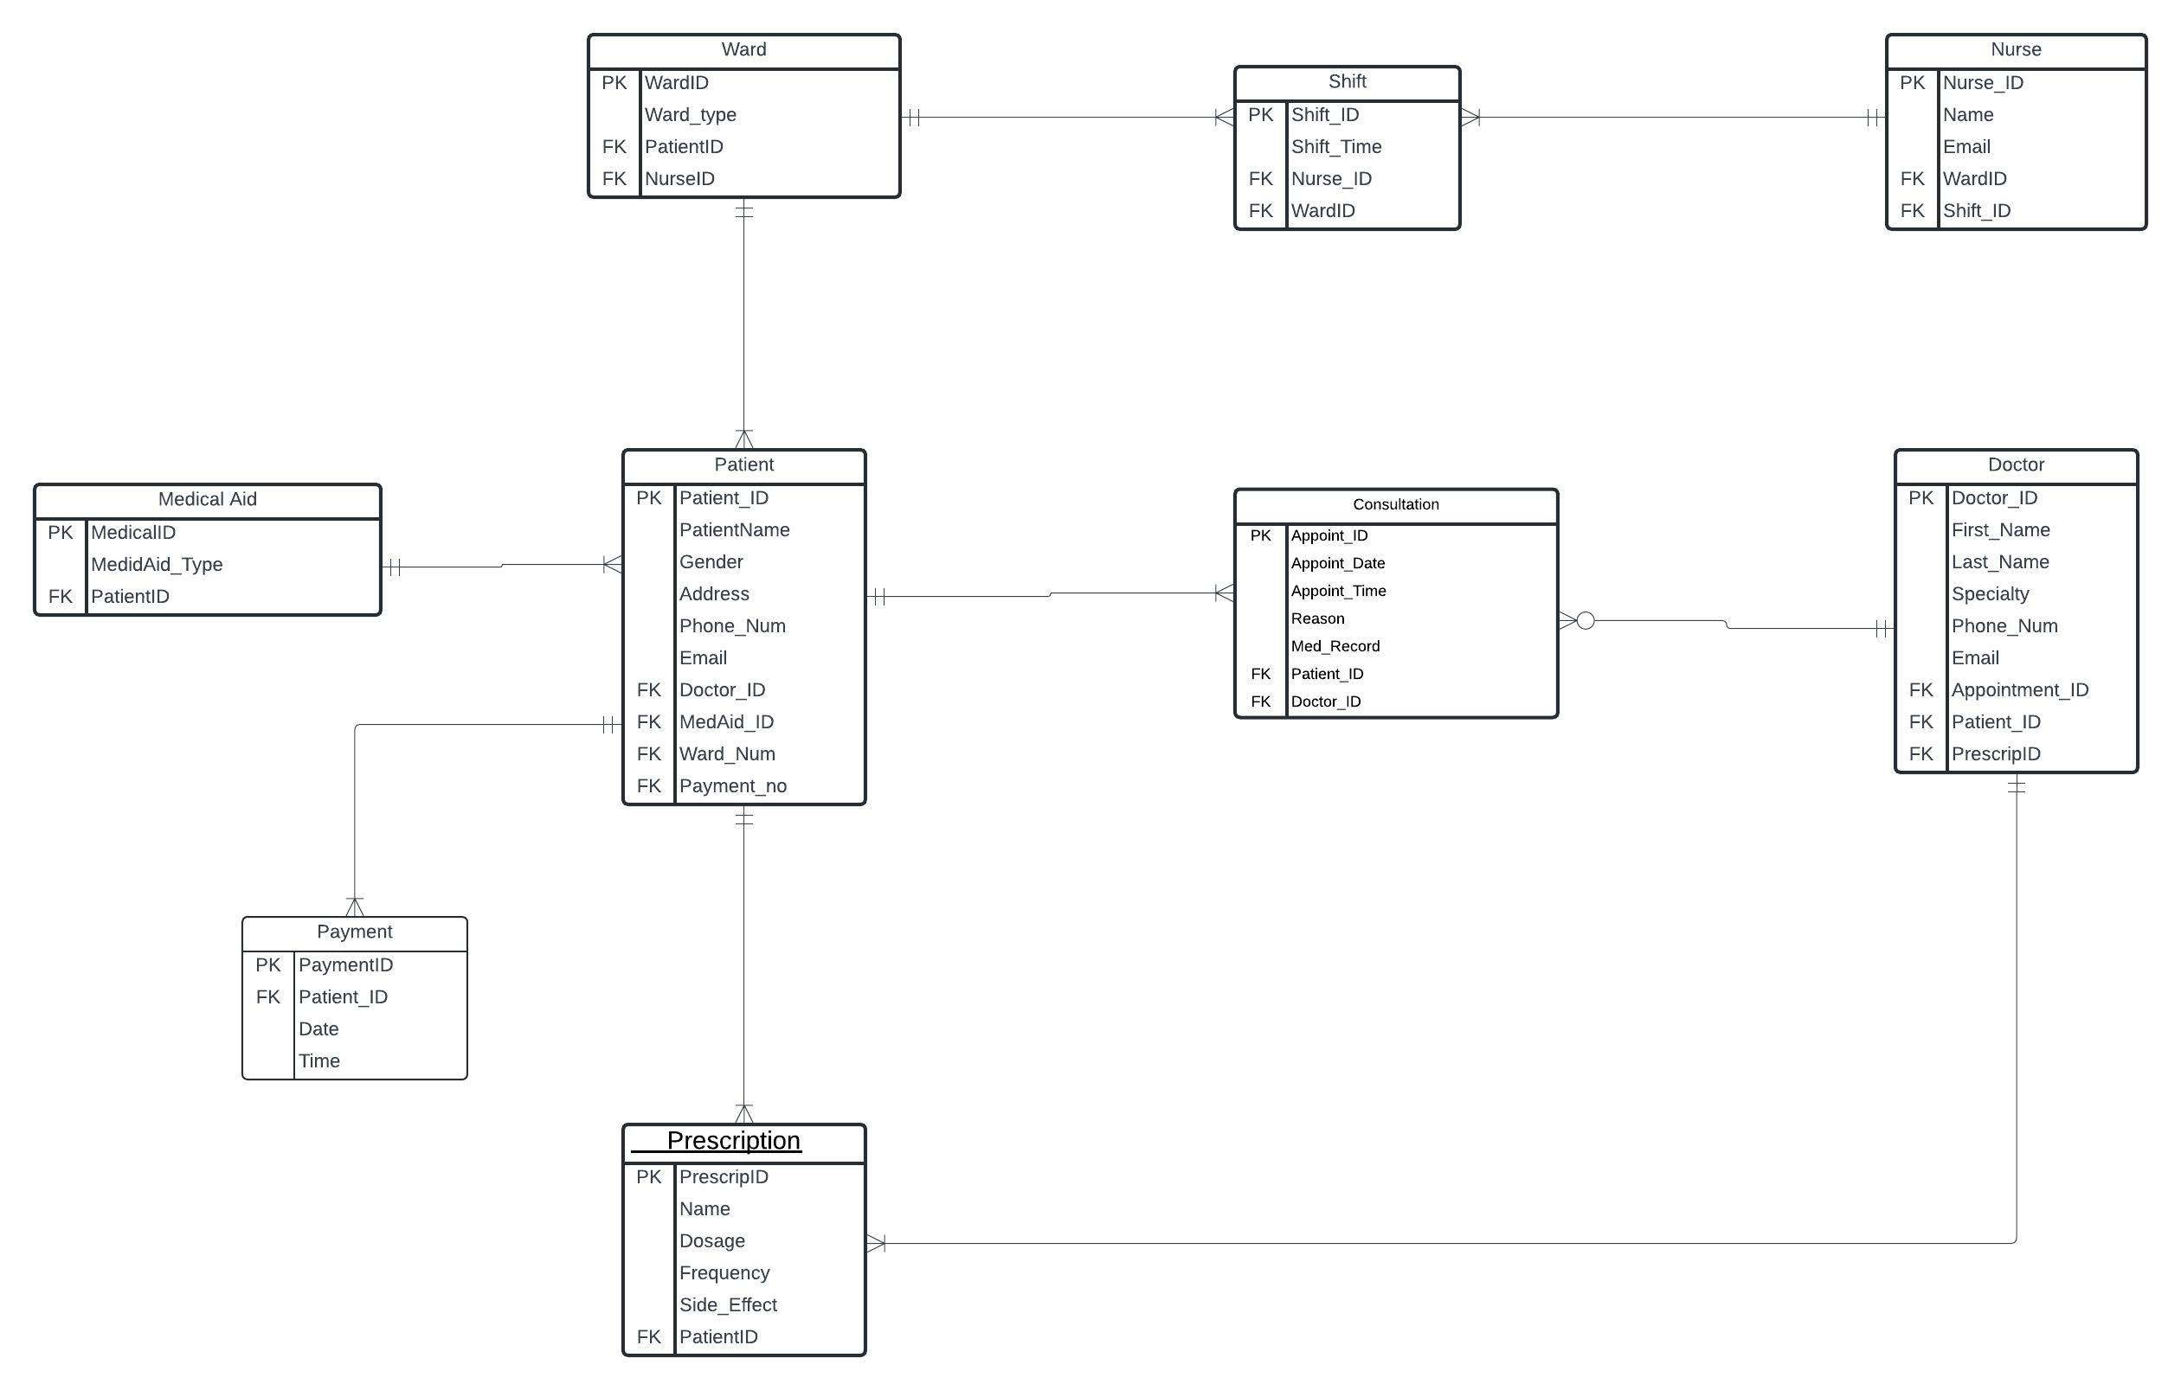
ENTITY RELATIONSHIP DIAGRAM
The ERD illustrates the main entities in our database system, including Patient, Doctor, Consultation, and Medical Aid. Each entity has specific attributes relevant to hospital operations, and relationships are defined to reflect the real-world interactions among these entities. For example, a patient can have multiple consultations, each linked to a specific doctor, while medical records are associated with individual patients and can only be accessed by authorized personnel.

Slide 5
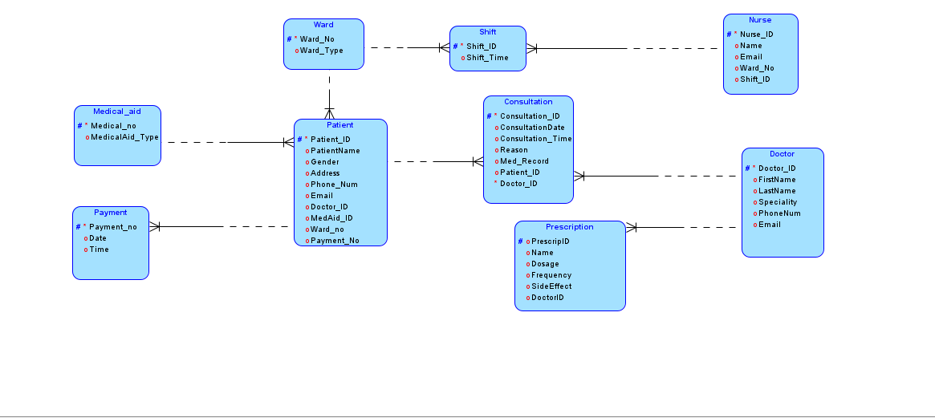
Oracle Data Modeler Implementation
Using Oracle Data Modeler, we transformed the ERD into a structured database schema. The tool allowed us to define constraints, specify data types, and ensure referential integrity between tables. Each table was refined and validated for optimized storage and access, with a focus on maintaining data accuracy and integrity throughout the system.

Slide 6

Database Schema Design
The database schema includes core tables such as Patients, Doctors, Appointments, and Medical Records. Primary and foreign keys establish relationships, ensuring data consistency across the database. To reduce redundancy, we applied normalization principles, making the data structure both efficient and manageable. Key tables also include constraints to prevent errors and enforce data integrity.

Slide 7
Coding with Developer
In Oracle Developer, we wrote SQL scripts to create and populate the database tables, ensuring that data entry is smooth and efficient. We also developed stored procedures for common tasks, such as admitting a new patient or updating medical records, automating key operations to minimize manual errors and save time for hospital staff.

Slide 8

Benefits of the Database System
This hospital database system brings multiple benefits: it enhances operational efficiency by organizing patient data in one accessible location, improves patient care with faster record retrieval, and provides robust security features to protect sensitive information. Overall, the system reduces administrative overhead and allows healthcare providers to focus more on patient care.

Slide 9
Conclusion
In summary, our hospital database system provides a reliable, secure, and efficient solution for managing patient data. By centralizing information, enhancing security, and optimizing data access, it contributes to better hospital operations and patient care. We’re excited about the potential for future enhancements to further support healthcare providers and patients alike.

